Slide 1
Web Development 2

Slide 2
Day 1

Slide 3
Agenda
Course overview
HTML forms
Project 1a
Project 1b
Lab time

Slide 4
Response Times for Technical Issues
If contacting me on a class day, expect a response within a couple of hours
If contacting me on a non-class day, expect a response within 48 hours between Monday and Friday
If contacting me during the weekend or a holiday, expect a response on the next business day

Slide 5
Solving Technical Issues
I am always available to help with any technical or code issues. With that said, I encourage you to do your best to solve problems on your own or with the help of of your classmates
Steps for troubleshooting
Determine what the problem is
Check for any error reporting by your development software
VS Code -> look for strange colouring of the code or underlines
Browser -> Utilize developer tools…Do you notice any CSS being crossed out in dev tools…If the problem is JS based…then check the console
Google any error messages or just google the issue you are having
Consult your classmates
Again…I am also here to help if all else fails…

Slide 6
HTML Forms

Slide 7
Forms - Introduction
Forms allow web sites users to interact with your web site
You can use forms to do the following:
Collect data from users
Logging into a site
To perform calculations
Enable users to contact you
To pay for items online
To search for something online

Slide 8
How a Form Works
User fills in the form
User submits the form
Data from the form is sent to the form processor which is a server script that runs on a web server
Not all forms are sent to the server, some forms such as calculators can be processed locally and never require data to be sent to a server
The form is processed
Feedback can optionally be given to the user to assure them that their information has been received

Slide 9


How a Form Works
4. Form processed
1. Form filled in
2. Form submitted
3. Form sent to server
Internet
5. Feedback sent to user
Desktop computer photo: This Photo by Unknown Author is licensed under CC BY-SA-NC
Wed server photo: This Photo by Unknown Author is licensed under CC BY-NC

Slide 10
Form Tag
The form tag wraps form elements and enables the sending of data inputted into a form to a web server
The form tag can include the following attributes:
action
The location of the form processing file
Form processing is usually done on the server side
Form processing will be covered in PHP
Not all forms require submission to a server
method
Determines how the data is sent from the client to the server
The values are:
get (useful for search forms)
post (the most common method for most forms)
name
Provides a way to identify the form to the server

Slide 11
Form Tag
The action attributes tells the browser where to send the form data
The method element determines how the data is sent to the server.
<form action="processor.php" method="post">
<!-- Form input elements go here... -->
</form>

Slide 12
Should I use GET or POST
Setting the method attribute to “get” means the form data will be sent out in the open in the URL address
Do not use “get” for sensitive form data like credit cards, usernames, emails, passwords and other personal information
For most forms you should use “post”
Use ”get” for search forms if you want to allow the user to bookmark a search query
Use “post” for most forms
Post data is stored in the request body of the HTTP request¹
1. https://www.w3schools.com/tags/ref_httpmethods.asp

Slide 13
Input Tag
The input tag creates an element that can be used to input data by a user of a web site
The input tag can have several “types” which determine the type of data that should be entered into the input element
Types of HTML and HTML5 inputs include but are not limited to the following:
checkbox, email, tel, radio, text, password, number, button and submit

Slide 14
Input Tag
Some common input tag attributes include:
type
Determines the input type
name
Identifies the input for the server
Used by radio and checkbox input types to group them together
disabled
Used to disable an input and to not submit any value to the server
readonly
Used to make an input read only and to send a value to the server
required
Used to tell the browser to require and validate that this input has been filled in

Slide 15
Input Tag
The “name” attribute is used to identify the input to the server. The “name” attribute is also used radio and checkbox input types to group them together
The “id” attribute is used to link a label to an input
<input type="text" id="firstname" name="fn">
The “type” attribute determines the type of input

Slide 16
Label Tag
The label tag provides a label for an input element
The label tag can be linked to a form element by using the for attribute
The “for” attribute value should match the “id” attribute value of the input element that it is a label of

Slide 17
Label Tag
<label for="firstname">Firstname: </label>
<input id="firstname" type="text" name="fn">
The “for” attribute value must match the id of the input element that it is a label of

Slide 18
Textarea Tag
The “textarea” tag is used for inputs where you need the give the user the ability to enter multiple lines of text or a large amount of text
Useful for comments
<label for="comments">Comments: </label>
<textarea id="comments" name="comments"></textarea>

Slide 19
Input Type - Submit
An input with the “type” of “submit” is used to submit the form data
When the “submit” input is clicked on the browser will send the form data to the location specified by the “action” element on the ”form” element
The “value” attribute determines what text appears in the button
<input type="submit" value="Submit">

Slide 20
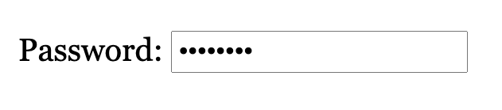
Input Type – Password
Used for password inputs
Text entered by the user is hidden visually by the browser
<label for="pw">Password: </label>
<input id="pw" type="password" name="pw">

Slide 21
Input Type - Checkbox
Allows the user to select multiple options with a ”checkbox” interface
Use “checkbox” when you want to give the user the ability to select multiple options
To create a “checkbox” group make sure the each “checkbox” input has the same “name” attribute value

Slide 22
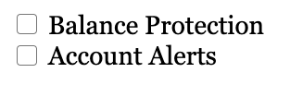
Input Type - Checkbox
<input type="checkbox" name="a-features" id="b-pro" value="balance protection">
<label for="b-pro">Balance Protection </label>
<input type="checkbox" name="a-features" id="a-alerts" value="account alerts">
<label for="a-alerts">Account Alerts </label>
To create a “checkbox” group make sure the each “checkbox” input has the same “name” attribute value

Slide 23
Input Type - Radio
Allows the user to select one option from a group of options with a ”radio” button interface
Use “radio” when you want to give the user the ability to select only one option from a group of options
To create a “radio” group make sure the each “radio” input has the same “name” attribute value

Slide 24
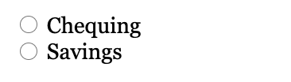
Input Type - Radio
<input type="radio" name="account-type" id="chequing" value="chequing">
<label for="chequing">Chequing </label>
<input type="radio" name="account-type" id="savings" value="savings">
<label for="savings">Savings </label>
To create a “radio” group make sure the each “radio” input has the same “name” attribute value

Slide 25
Input Type - Hidden
An input with the type of “hidden” will not be displayed visually by the browser
Hidden inputs form data is sent to the server for processing
Useful to send form data to a server that you do not need or want the user to enter into a form
<input type="hidden" name="user-id" value="abc12345">

Slide 26
Select List
Creates a select list form element
Can be configured to allow the user to select only one option or multiple options
The size attribute allows you to configure the amount of options that are visible to the user before they activate the dropdown
Will look different depending on the browser and the operating system
Difficult to fully customize the appearance, but some styling is possible

Slide 27
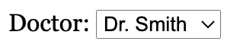
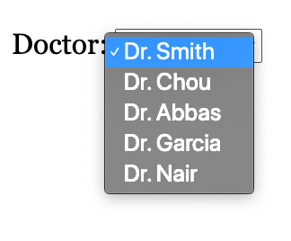
Select List
Select list in the open state (Chrome Browser, macOS)
Select list in the closed state (Chrome Browser, macOS)
<label for="doctor">Doctor: </label>
<select id="doctor" name="doctor">
<option value="Smith">Dr. Smith</option>
<option value="Chou">Dr. Chou</option>
<option value="Abbas">Dr. Abbas</option>
<option value="Garcia">Dr. Garcia</option>
<option value="Nair">Dr. Nair</option>
</select>

Slide 28
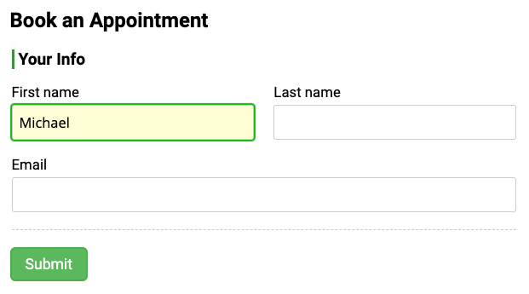
Focus State
One use of the “:focus” pseudo selector is style form elements when a user clicks into or focuses into a form input element
Changing the style of the input that the user has focused into helps inform the user where they are in the form
This input has additional styles applied when the input is focused using the “:focus” pseudo selector

Slide 29
Focus State
The “:focus” pseudo selector applies when a user clicks into or focuses into an input element
input[type="text"]:focus,
input[type="email"]:focus {
background-color: #fdfdd6;
outline: none;
box-shadow: 0 0 1px 2px #13b613;
border-radius: 3px;
}

Slide 30
Placeholder Attribute
The placeholder attribute should be used to provide a short hint (a word or short phrase) intended to aid the use with data entry when the control has no value¹
Use the placeholder attribute with caution (see next slide)
The placeholder attribute is NOT a substitute for label elements (see next slide)
Give the below linked article a read to learn about some of the issues with the placeholder attribute
https://www.smashingmagazine.com/2018/06/placeholder-attribute/
https://www.smashingmagazine.com/2018/06/placeholder-attribute/

Slide 31
Placeholder Attribute as Label
Note: Hiding labels and using placeholders inside form input elements as labels should be used with caution. Read the Nielsen Norman Group article Placeholders in Form Fields Are Harmful for reasons to perhaps not use this technique.

Slide 32
Placeholder Attribute as Label
Warning: Never omit label tags in your markup, even if you are using this placeholder as label technique. People using screen readers rely on labels to use forms properly. Placeholders are NOT a substitute for labels in your HTML. Use CSS to visually hide your labels (DO NOT use display: none;). Use a visually hidden style such as that used by Bootstrap's "sr-only" class. See the next slide for a CSS code snippet that will allow you visually hide an element but still make the element accessible to screen readers.
DO NOT BE A LAZY DEVELOPER!!!. Always use label tags and tie them to their corresponding inputs with a for attribute on the label tag that matches the id attribute on the corresponding input element, even if your labels are not visible.

Slide 33
Bootstrap 3 sr-only Class
Use this CSS code snippet from Bootstrap 3 to visually hide an element but still make it accessible to screen readers
.sr-only {
position: absolute;
width: 1px;
height: 1px;
padding: 0;
margin: -1px;
overflow: hidden;
clip: rect(0 0 0 0);
border: 0;
}
Code snippet from this stackoverflow question and answer: https://stackoverflow.com/a/19340317

Slide 34
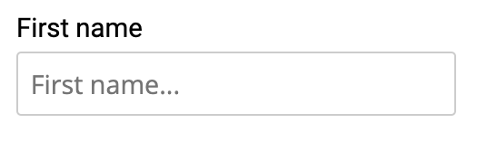
Placeholder Attribute
<label for="fn">First name</label>
<input type="text" id="fn" name="fn" placeholder="First name...">

Slide 35
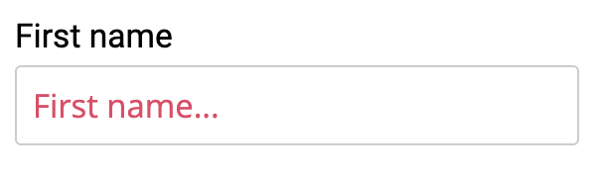
Styling the Placeholder Attribute
Styling the Placeholder can be tricky as different browsers support a slightly different syntax for the “::placeholder” pseudo selector
HTML input element with a placeholder attribute styled to with a red text color

Slide 36
Styling the Placeholder Attribute
CSS syntax for styling the placeholder attribute for Chrome, Firefox and Chromium based Microsoft Edge
input::placeholder {
color: #d84f69;
/* Firefox fades the text using opacity
- If you want a consistent look between
browsers, set the opacity to 1
*/
opacity: 1;
}

Slide 37
Styling the Placeholder Attribute
CSS syntax for styling the placeholder attribute for non-Chromium based Microsoft Edge
input::-ms-input-placeholder {
color: #d84f69;
}

Slide 38
Styling the Placeholder Attribute
CSS syntax for styling the placeholder attribute for IE 10+
input:-ms-input-placeholder {
color: #d84f69;
}

Slide 39
HTML Form Validation
HTML5 introduced simple HTML form validation without any need for JavaScript
You can use the ”required” attribute on an input to make sure the user enters data on an input element
If you want more custom looking form validation then you will need to turn to JavaScript
Note: HTML form validation using the built-in HTML validation or using custom JavaScript validation is not secure. Always validate the data a 2nd time on the server when receiving data from an HTML form

Slide 40
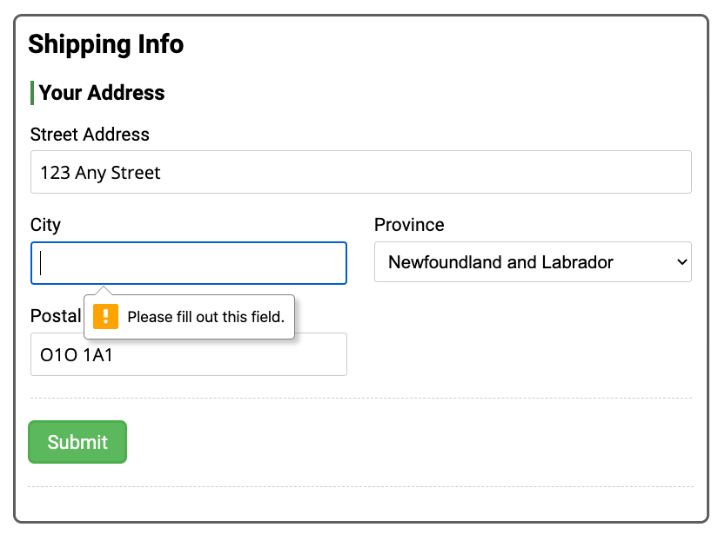
HTML Form Validation
<label for="city">City</label>
<input type="text" id="city" name="city" required>

Slide 41
Form Validation with the Pattern Attribute
Using the required attribute alone allows for basic validation to make sure the user at least inputted something into an input
If you require something a bit more custom, you can use the “pattern” attribute to make the browser validate an input against a regular expression
A regular expression is a pattern that the computer uses to test a string of text against
With a pattern attribute you can validate for Credit Card numbers, postal codes, phone numbers and other common types of data
For some pre-written HTML5 pattern values visit this web site:
http://html5pattern.com/
Use the title attribute to provide helper text to the user if they input invalid data

Slide 42
Form Validation with the Pattern Attribute
<input type="text"
id="postal-code"
name="postal-code"
pattern="[A-Za-z][0-9][A-Za-z](\s)?[0-9][A-Za-z][0-9]"
title="Format: A1A 1A1"
required>
You can use the title attribute to display a helper message to the user if they enter incorrectly formatted data
The pattern attribute tells the browser to test the input entered by the user against the regular expression set in the pattern attribute. The pattern here will test for a Canadian postal code (A1A 1A1)

Slide 43
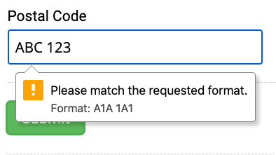
Form Validation with the Pattern Attribute
This input is being validated against a custom pattern set via the “pattern” attribute on the input element. This input is being validated for a Canadian postal code (A1A 1A1).
Visit http://html5pattern.com/ to get some common pattern values for things such as telephone numbers, credit cards, postal codes and other common types of information
The text “Format: A1A 1A1” comes from the title attribute on the input element

Slide 44
Project 1a and 1b

Slide 45
Project Overview
Research a new web technology as part of a group and present what you have learned to the class
Create a website that provides an overview of the technology that you researched
This is a group project
The instructor will assign groups
Groups will be the same for both projects 1a, 1b, and 2
Due December 4 – 6
Depends on the selected presentation date
More details can be found on the instruction sheet for this project

Slide 46
Project Objectives
Group Collaboration: Learn the essentials of effective teamwork, contributing equitably to a shared goal.
Modern Web Tools: Gain hands-on experience with contemporary web tools like Git for version control and Sass for CSS pre-processing.
Exploratory Research: Investigate emerging trends or technologies in web development and summarize findings.
Knowledge Sharing: Share acquired insights with the class via a presentation and website, fostering a collaborative learning environment.
Presentation Skills: Develop the ability to convey technical information clearly and compellingly.
Communication Skills: Build essential communication skills vital for succeeding in the professional world.
Note: The above points generated by ChatGPT from rough objectives provided by Michael Whyte

Slide 47

Groups
Groups will be randomly selected in class
Group size will be 4 – 5 students
Groups will be the same for all projects for the Web Development 2 course

Slide 48
Benefits of Group Work
Diverse Perspectives: Access to a variety of viewpoints that can lead to more comprehensive solutions.
Skill Enhancement: Opportunity to learn from peers, thus improving one's skill set.
Resource Pooling: Sharing of resources, be it time, expertise, or tools, to more efficiently achieve project goals.
Shared Responsibility: Workload distribution among team members can lead to better time management and less stress.
Accountability: Regular group meetings and peer evaluations can foster a sense of responsibility.
Conflict Resolution: Learning to resolve disagreements constructively is a valuable workplace skill.
Social Skills: Interaction within a group helps improve interpersonal skills, including communication and empathy.
Note: The above edited points were originally generated by ChatGPT

Slide 49

Topic Selection
Each group must select a unique topic
Topics are selected on a first-come-first-serve basis
When your group has selected a topic, notify your instructor

Slide 50
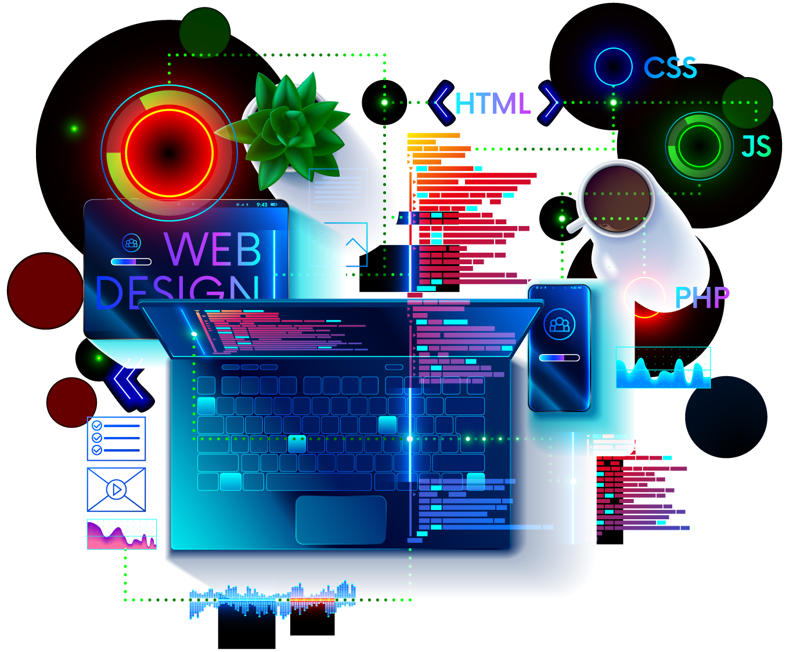
Topic Selection
Available Topics
CSS Custom Properties (CSS Variables)
CSS Transitions, Transforms, and Animations
CSS Selectors Beyond Class, ID, and Element Selectors
3 - 5 New or Up-and-Coming CSS Technologies
SVG
Markdown
Bootstrap or Similar Framework
Web APIs such as Geolocation, Fetch, and Web Storage
Static Site Generators
Progressive Web Apps
Other Topics with Instructor Approval

Slide 51
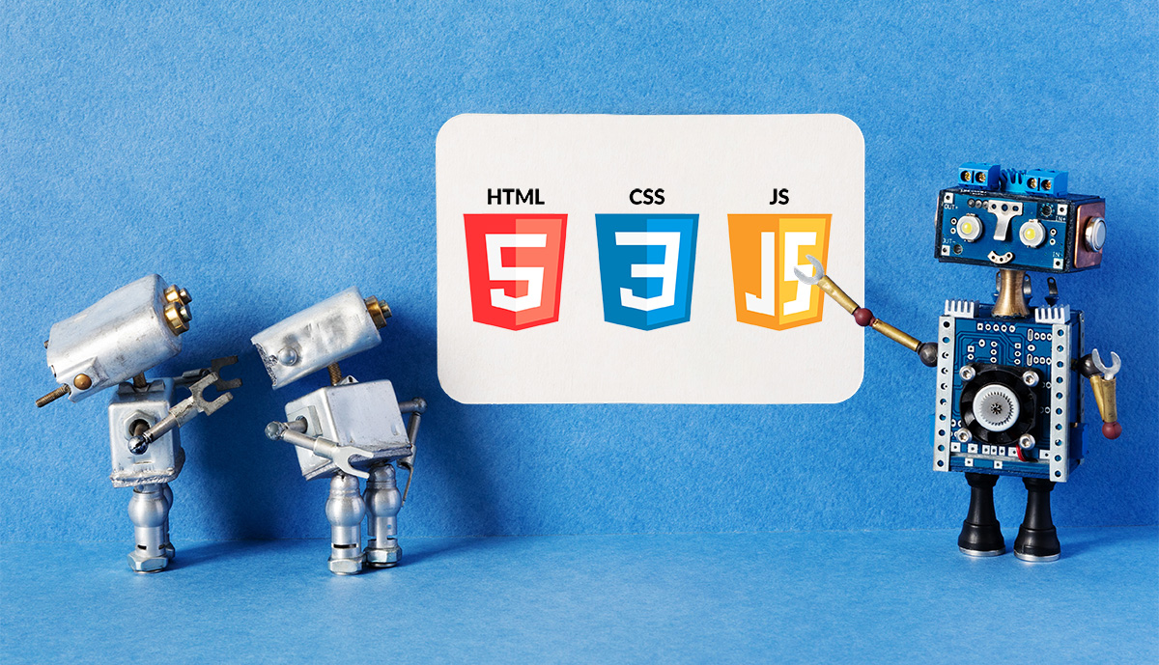
Project 1a - Presentation
Duration 10-20 minutes
Content Requirements
Technology Overview
What is it
What does it do
Why would you use it
Where would you use it
Pros and Cons
A code demo or technology walk-through

Slide 52

Project 1b - Website
Technical Requirements
One or more page website
Hosted and shared using GitHub’s Pages feature
See this link for instructions on how to create a GitHub Pages site:
https://docs.github.com/en/pages/getting-started-with-github-pages/creating-a-github-pages-site
Share the URL to your site with the class in the Slack channel for the Web Scripting 3 course
Content Requirements
Like the presentation, answer the what, why, where, and how of your chosen topic

Slide 53
Project 1a – Presentation Rubric
Excellent level for the evaluation criteria
Topic Understanding: Demonstrate a comprehensive understanding of your selected web technology and articulate its use cases and applications well.
Code Demo and Walk-Through: Provide an exceptionally clear and insightful code demonstration that not only works but significantly contributes to the understanding of the technology.
Presentation Skills: Deliver a presentation that is exceptionally clear, engaging, and well-organized, capturing and maintaining the audience's attention throughout.
Group Collaboration: Exhibit clear evidence of equitable and effective collaboration among all group members, where everyone has contributed significantly to the project.
Relevance and Originality: Go beyond the basic requirements by adding unique perspectives or elements that are not only relevant but offer original insights into the topic.
Time Management: Adhere perfectly to the 10–20-minute guideline, utilizing the time effectively to cover all important points without rushing or stretching the content.

Slide 54
Project 1b – Website Rubric
Excellent level for the evaluation criteria
Content Quality: Present a comprehensive and insightful overview of the selected technology that fulfills all specified content requirements, leaving no gaps in information.
Design and Usability: Create an exceptionally user-friendly and visually appealing design that complements and enhances the content, ensuring a seamless user experience.
Code Quality: Develop clean, efficient code that adheres to industry best practices, demonstrating mastery over the technologies used.
GitHub Pages: Maintain a well-organized public repository and properly set up the GitHub Pages site. The URL should be shared as instructed, and the repository should facilitate easy navigation.

Slide 55
Project Submission
Live In-Class Presentation
One group member should submit a URL to the group’s GitHub Pages URL

Slide 56
Project Penalties
Presentation component
10% for not being in attendance for other group presentations
Website component
5% per to a maximum of 50%
No projects accepted that are more than 14 days late

Slide 57
Strategies for Effective Group Work
Clear Role Assignment: Define roles and responsibilities for each group member to ensure a balanced workload.
Communication Channels: Establish a regular communication channel such as Slack, Microsoft Teams, or regular meetings to keep everyone in the loop.
Timelines and Milestones: Develop a project timeline with milestones and deadlines to keep the team on track.
Conflict Resolution: Agree on a method for resolving conflicts or making decisions, whether by majority vote or consensus.
Note: The above edited points were originally generated by ChatGPT

Slide 58
Strategies for Effective Group Work
Version Control: Utilize version control tools like Git to manage changes and avoid work duplication.
Regular Check-ins: Schedule meetings to assess progress, discuss challenges, and recalibrate roles or tasks as needed.
Peer Reviews: Incorporate a peer review process to evaluate each other’s contributions and ensure high-quality output.
Feedback Loops: Create mechanisms for internal feedback before the final submission to improve the quality of the work.
Note: The above edited points were originally generated by ChatGPT

Slide 59
FAQs
What technology should my presentation be in?
You can use whatever you like…
PPT, Google Slides, Canva, or other web-based presentation tools could be used.
Create a web page and present that.
Create demo pages and show your code…
The goal of the presentation is to communicate what, why, where, and how of the technology to the class.
Can we show a pre-existing YouTube video not made by our group on the screen and call it a day?
No, however, if the video you are showing is less than 30% of the total duration of your presentation, then that is fine.
You are allowed to include links to videos or embed videos made by others on your GitHub Pages website.

Slide 60
FAQs
Can we use Bootstrap for our GitHub pages site?
Yes
Can we use other web technologies like Sass and jQuery?
Yes, if it is compatible with GitHub Pages
Can we upload our presentation to our GitHub pages site?
Yes, if you think it adds to your webpage.
Just make sure to link to it in your document. Don’t just upload it to your GitHub repo.
Do we have to attend the other group presentations?
Yes, if you do not attend the other groups’ presentations without a valid reason, you will receive a 10% penalty.

